Slide 1
2024 ANNUAL REPORT
A 501 (c) (3) Charitable Organization
Federal Tax ID #80-0228843

Slide 2
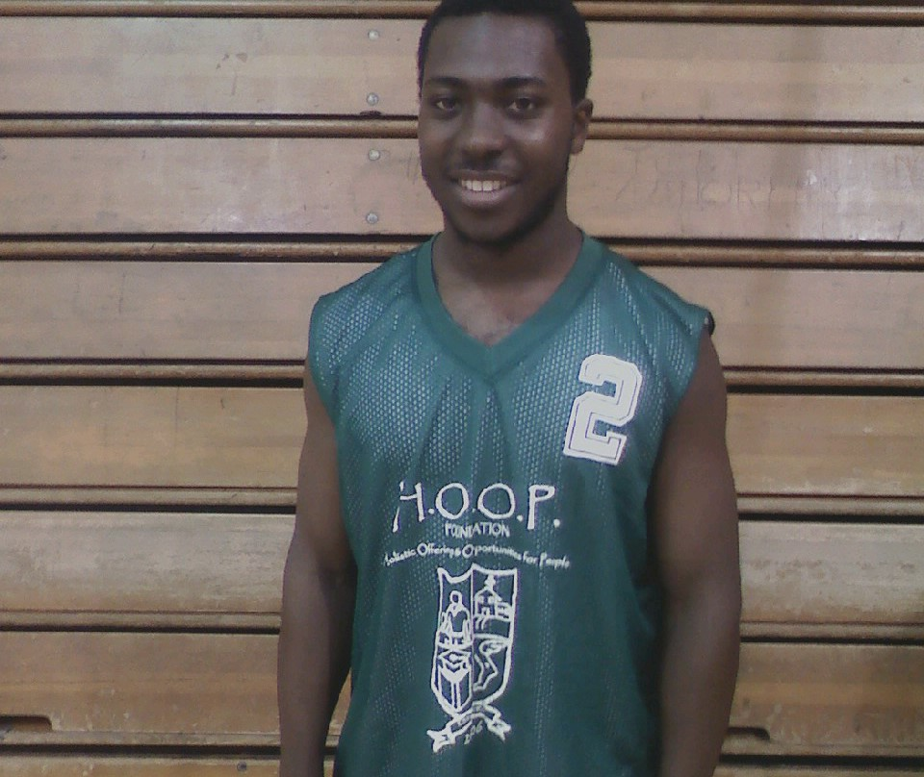
Who We Are
“To inspire and empower at-risk young people through access to sports and tutoring."
Holistic Offerings & Opportunity for People, Inc. was established in 2008 to engage families in the extremely low-income neighborhoods and uniquely address the obstacles inner - city youth face.
From the organization's inception, the need to engage foster, homeless, juvenile justice-involved, and underserved youth was evident through the various community assessments and surveys. In practice and theory, transforming individual behaviors is vital when deterring recidivism and reducing negative reactions to inequalities exacerbated by a lack of support or advocacy.
Youth need positive engagement, endorsement, encouragement, empowerment, and public acceptance.
A 501 (c) (3) Charitable Organization
Federal Tax ID #80-0228843

Slide 3
Letter from the Executive Director
Dear Board Members,
Reflecting on 2024, I am filled with pride and gratitude for the strides we have made together at the H.O.O.P. Foundation. This year has been marked by significant achievements in our mission to inspire and empower at-risk youth through sports, academic assistance, and mentoring. With your support, we have expanded our programs, secured vital funding, and positively impacted the lives of countless young individuals and families in our community.
Thank you for your dedication to our mission and your belief in the transformative power of our work. Together, we are building brighter futures.
Sincerely, Bryan C. Jones
Executive Director H.O.O.P. Foundation
A 501 (c) (3) Charitable Organization Federal Tax ID #80-0228843

Slide 4
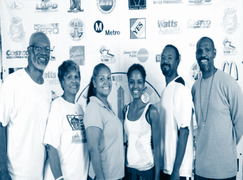
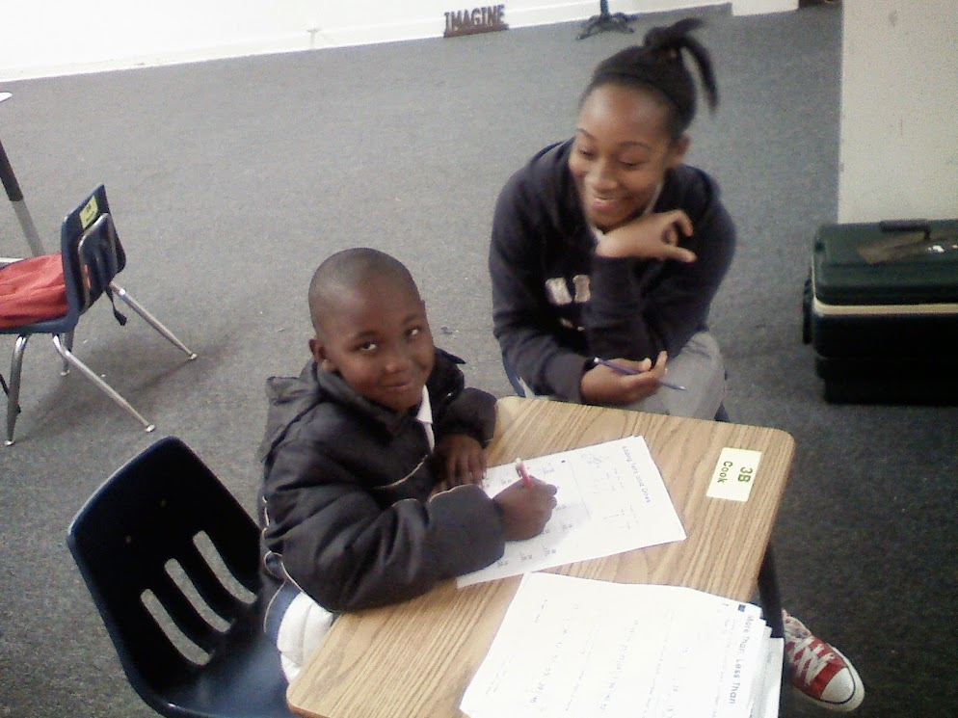
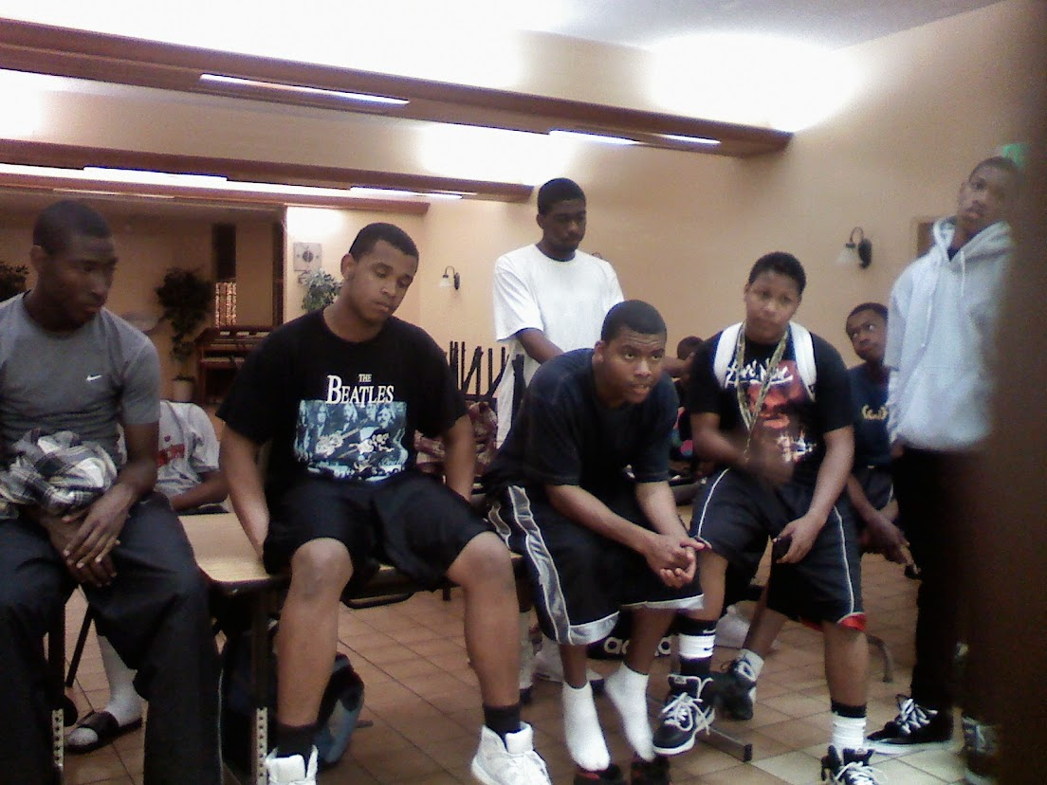
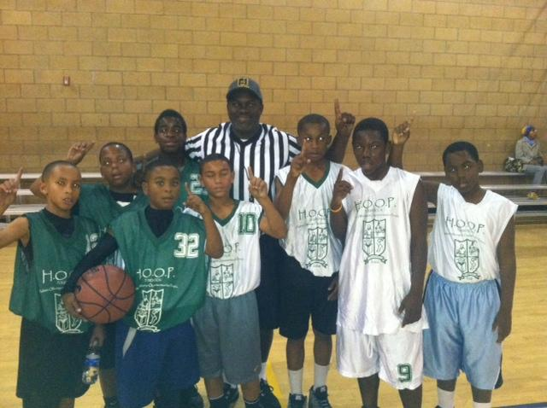
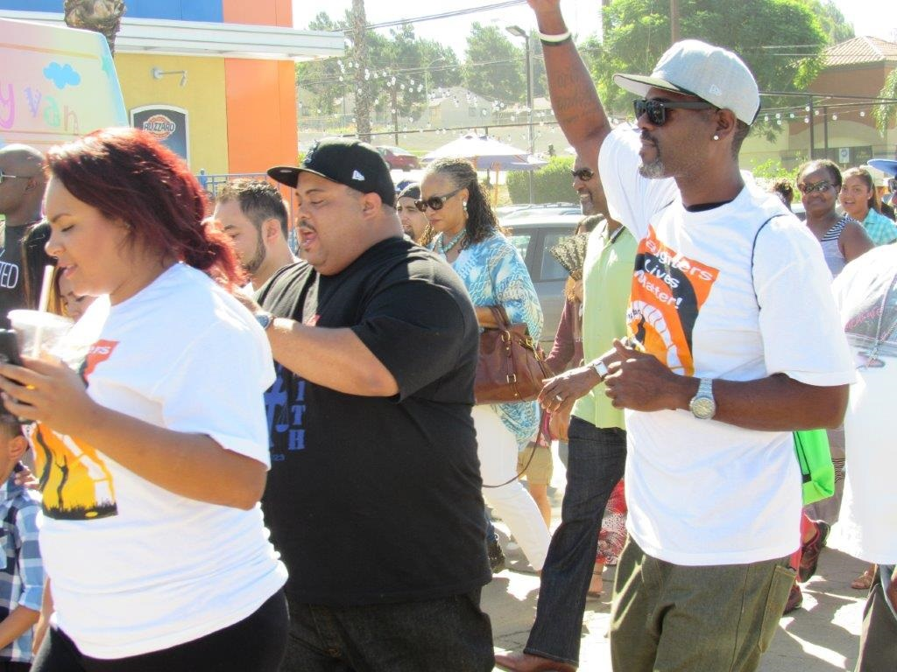
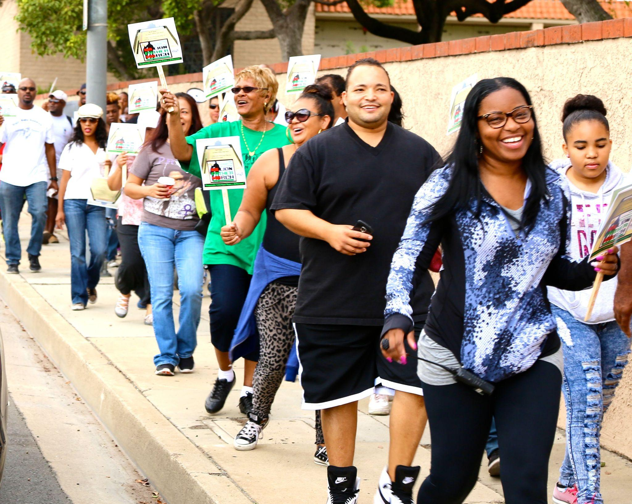
BRIEF HISTORY - OUR TIMELINE - 14 YEARS AND COUNTING
2008
Est. by Co- Founders
Tim Griffith \ Bryan C.Jones
2009
After-School Program
(18 -24 Yr Olds)
2010
LA Million Father March
Health Fair (Watts, CA)
2011
Fatherhood Breakfast
LA Million Father March
(Los Angeles,(CA)
A 501 (c) (3) Charitable Organization Federal Tax ID #80-0228843

Slide 5
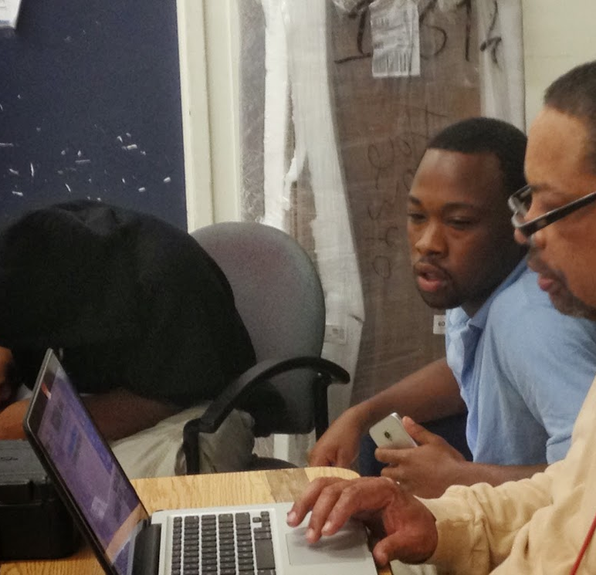
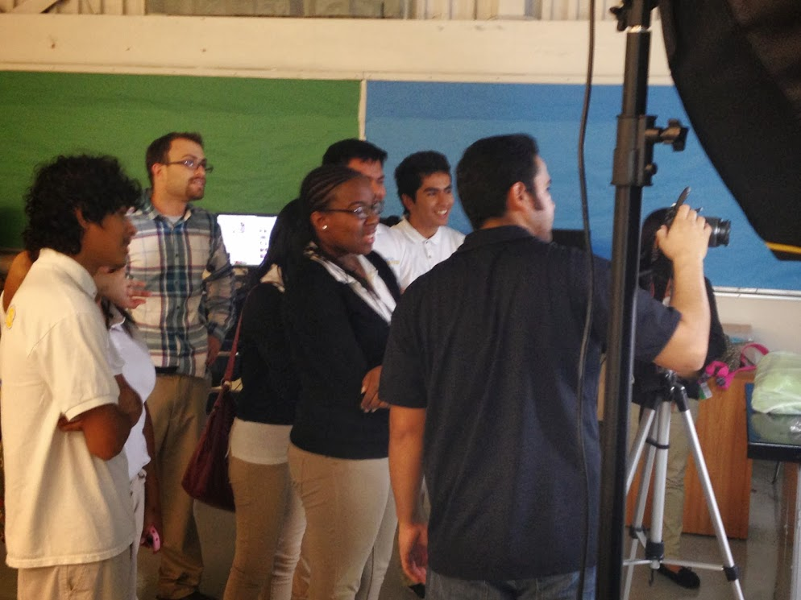
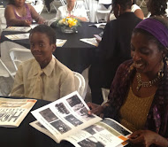
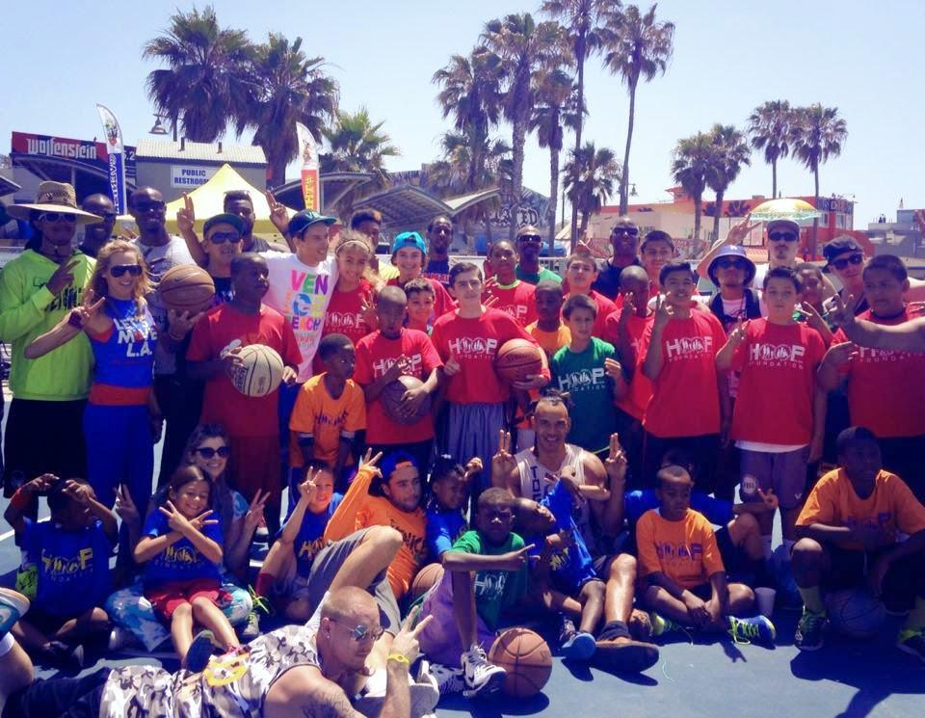
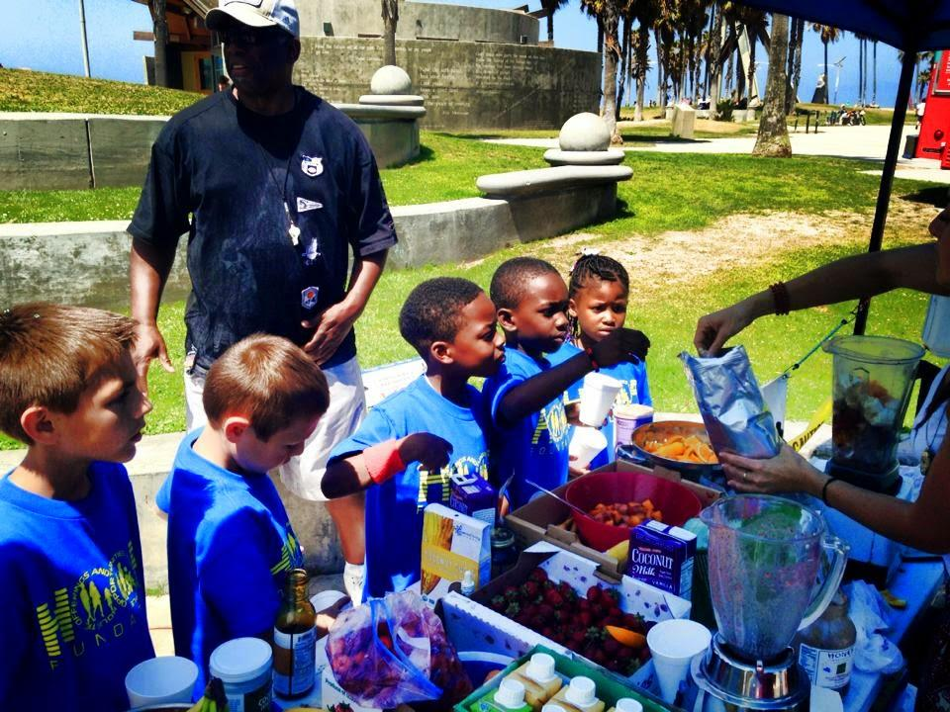
2012
H A.S. P.
H. O.O.P.
After School Program
(Locke, High School, LA, CA.)
2013
5TH YEAR CELEBRATION
(The Holman/A-MAN, Inc.
STEM Tech. Center, Inglewood, CA.)
2014
6TH ANNUAL
SHOES II FILL-TOY DRIVE
Basketball Tournament
2015
Kids Venice Basketball League (KVBL) Summer Camp (Venice, CA)
A 501 (c) (3) Charitable Organization Federal Tax ID #80-0228843

Slide 6
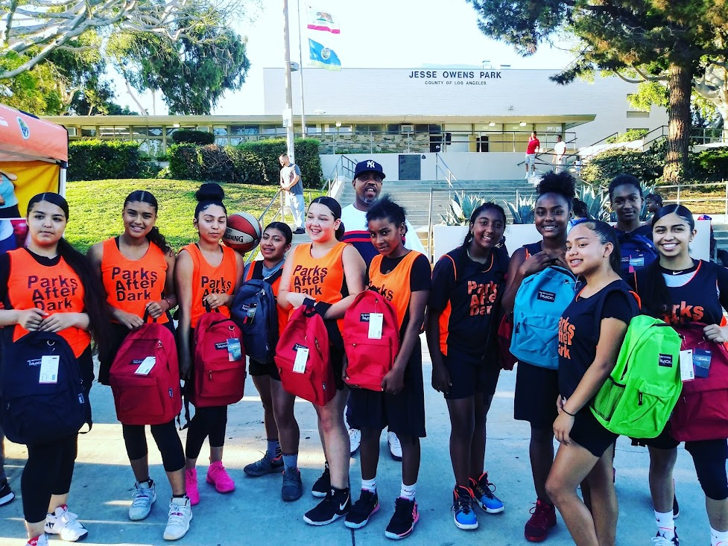
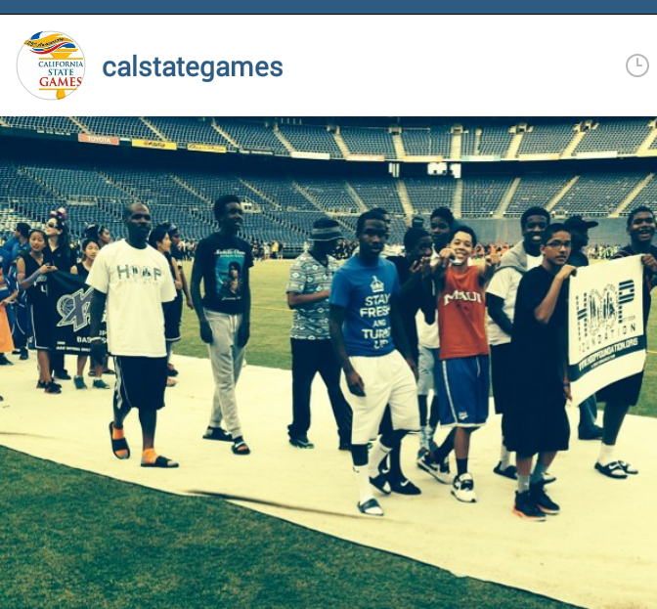
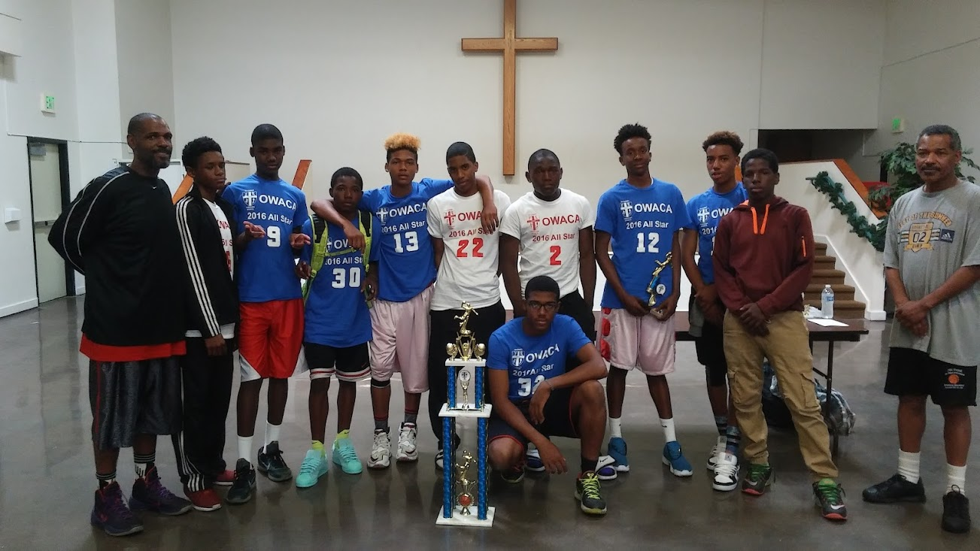
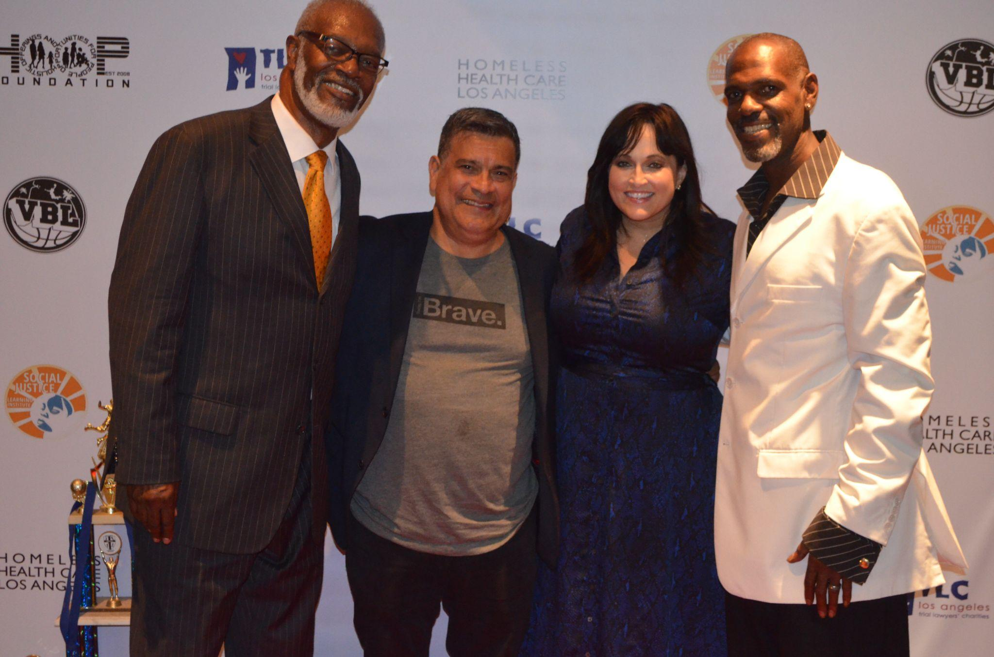
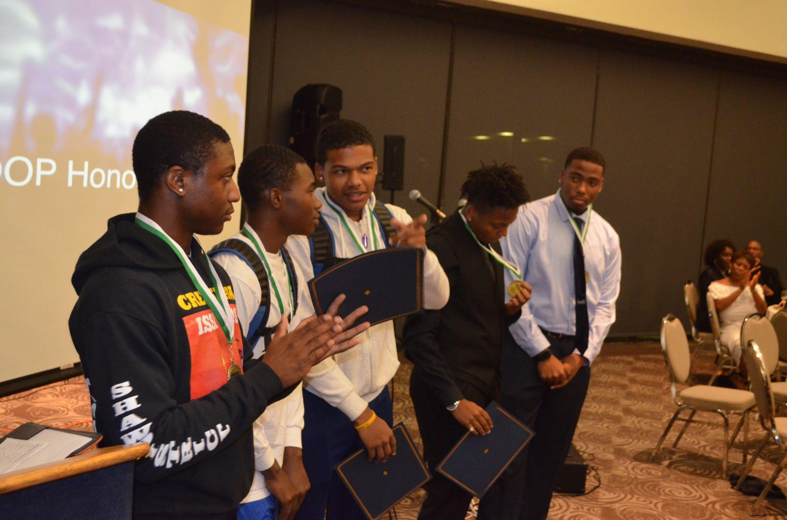
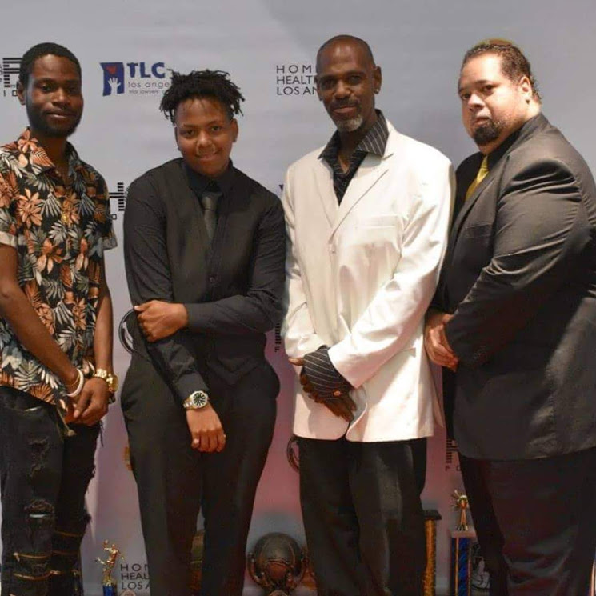
2016
California State Games
(San Diego, CA.)
OWACA League
(Los Angeles, CA.)
2017
2018
10th Year Anniversary Gala Award Dinner (Carson, CA.)
2019
California State Games
2nd Place
(San Diego, CA
1st All Girls Team
A 501 (c) (3) Charitable Organization Federal Tax ID #80-0228843

Slide 7
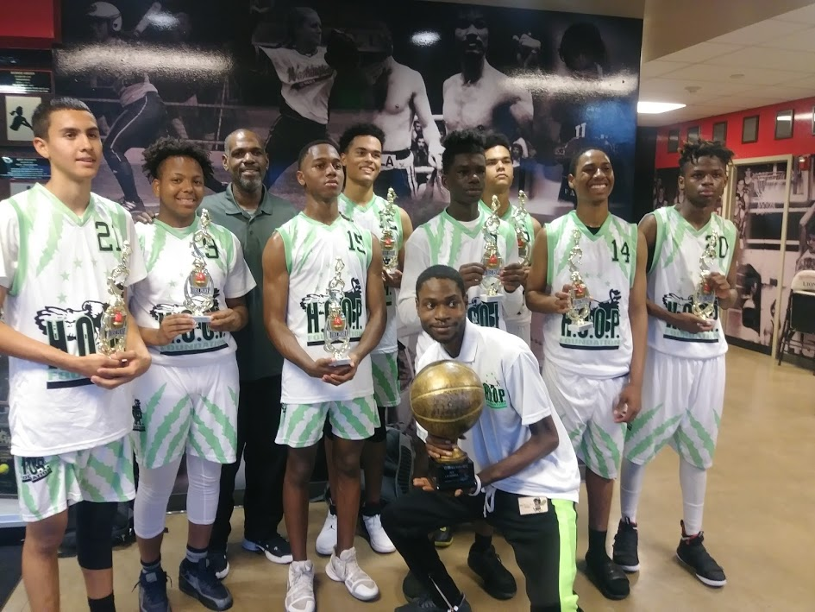
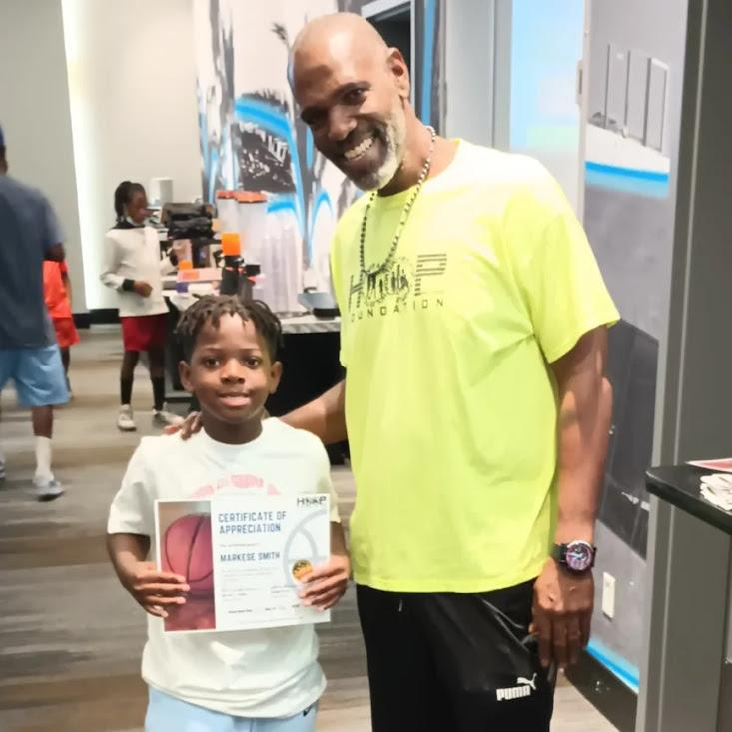
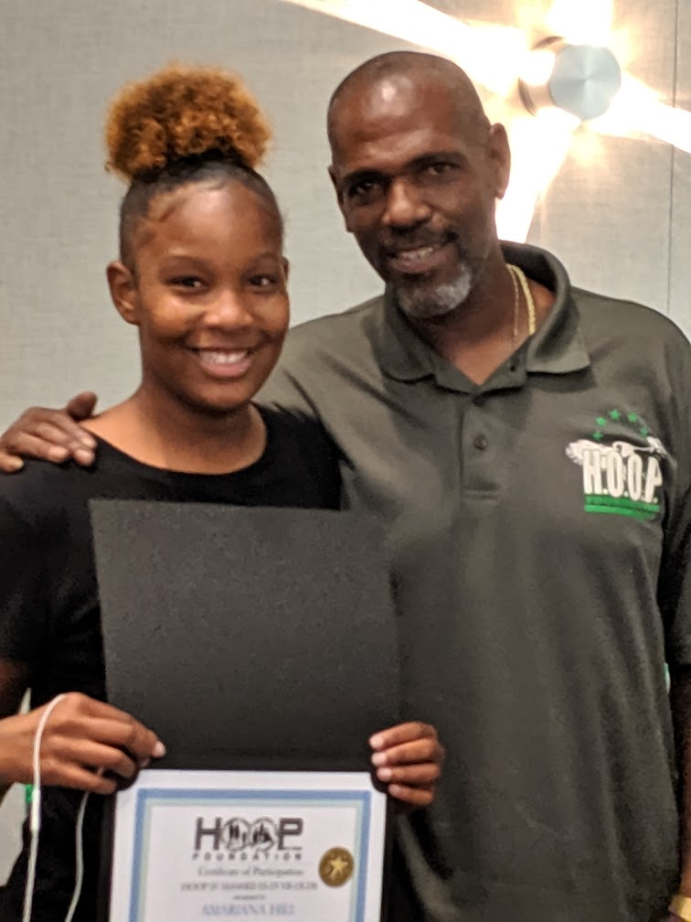
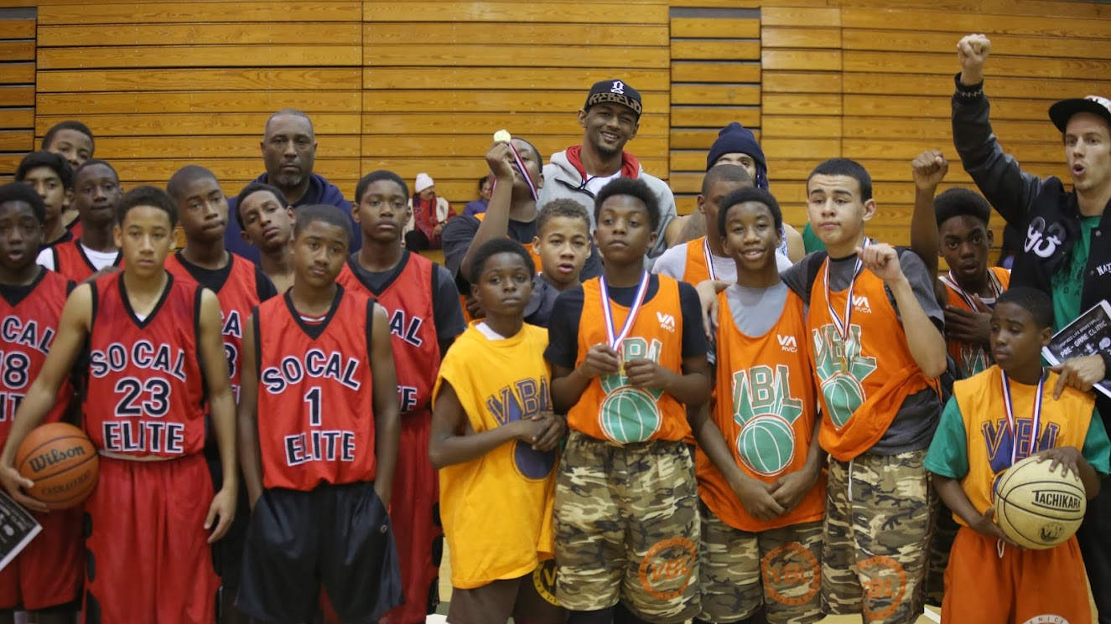
Jam On It
17 U Champions
(Las Vegas, NV.)
2020
2021
Kids Venice Basketball League (KVBL) Summer Camp (Venice, CA)
2022
14th Annual Awards Dinner
Westchester, CA
A 501 (c) (3) Charitable Organization Federal Tax ID #80-0228843

Slide 8
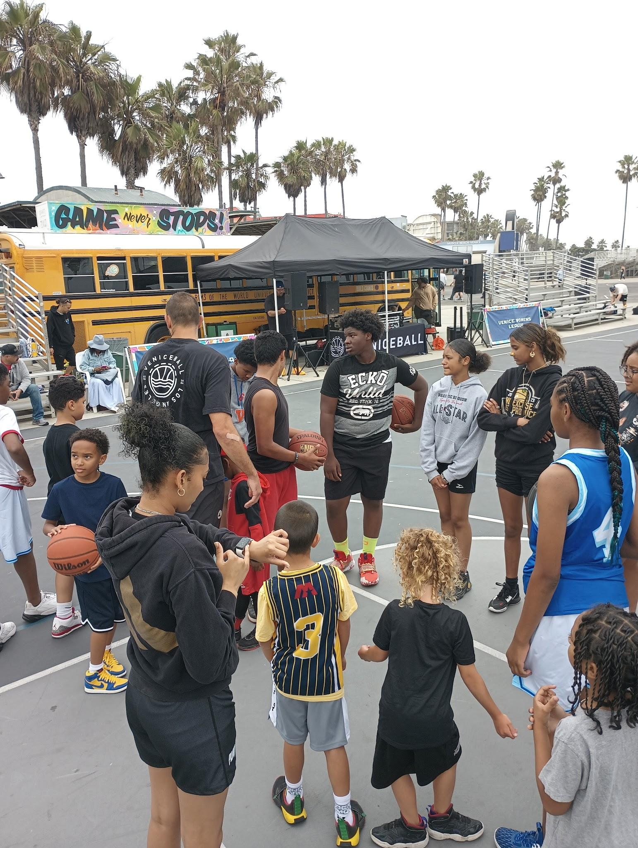
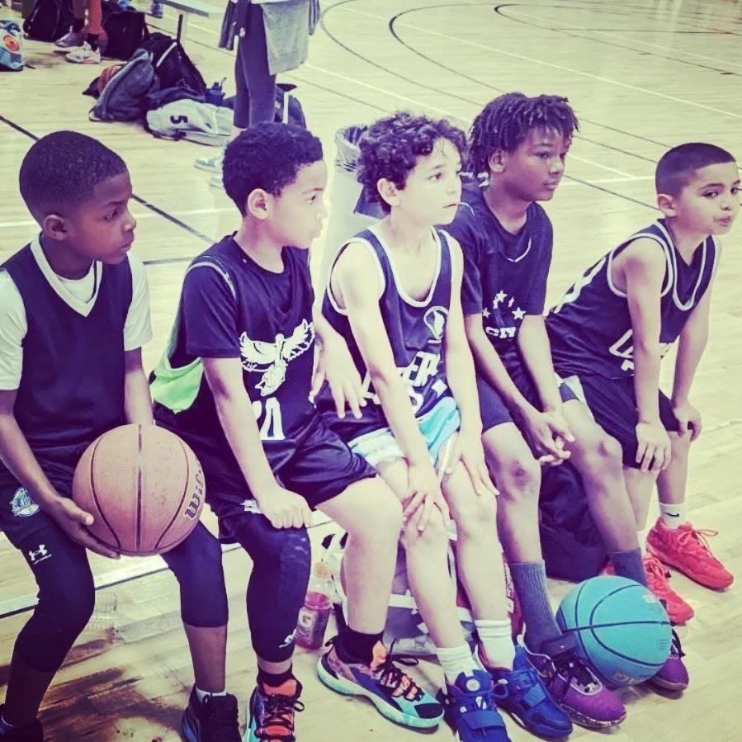
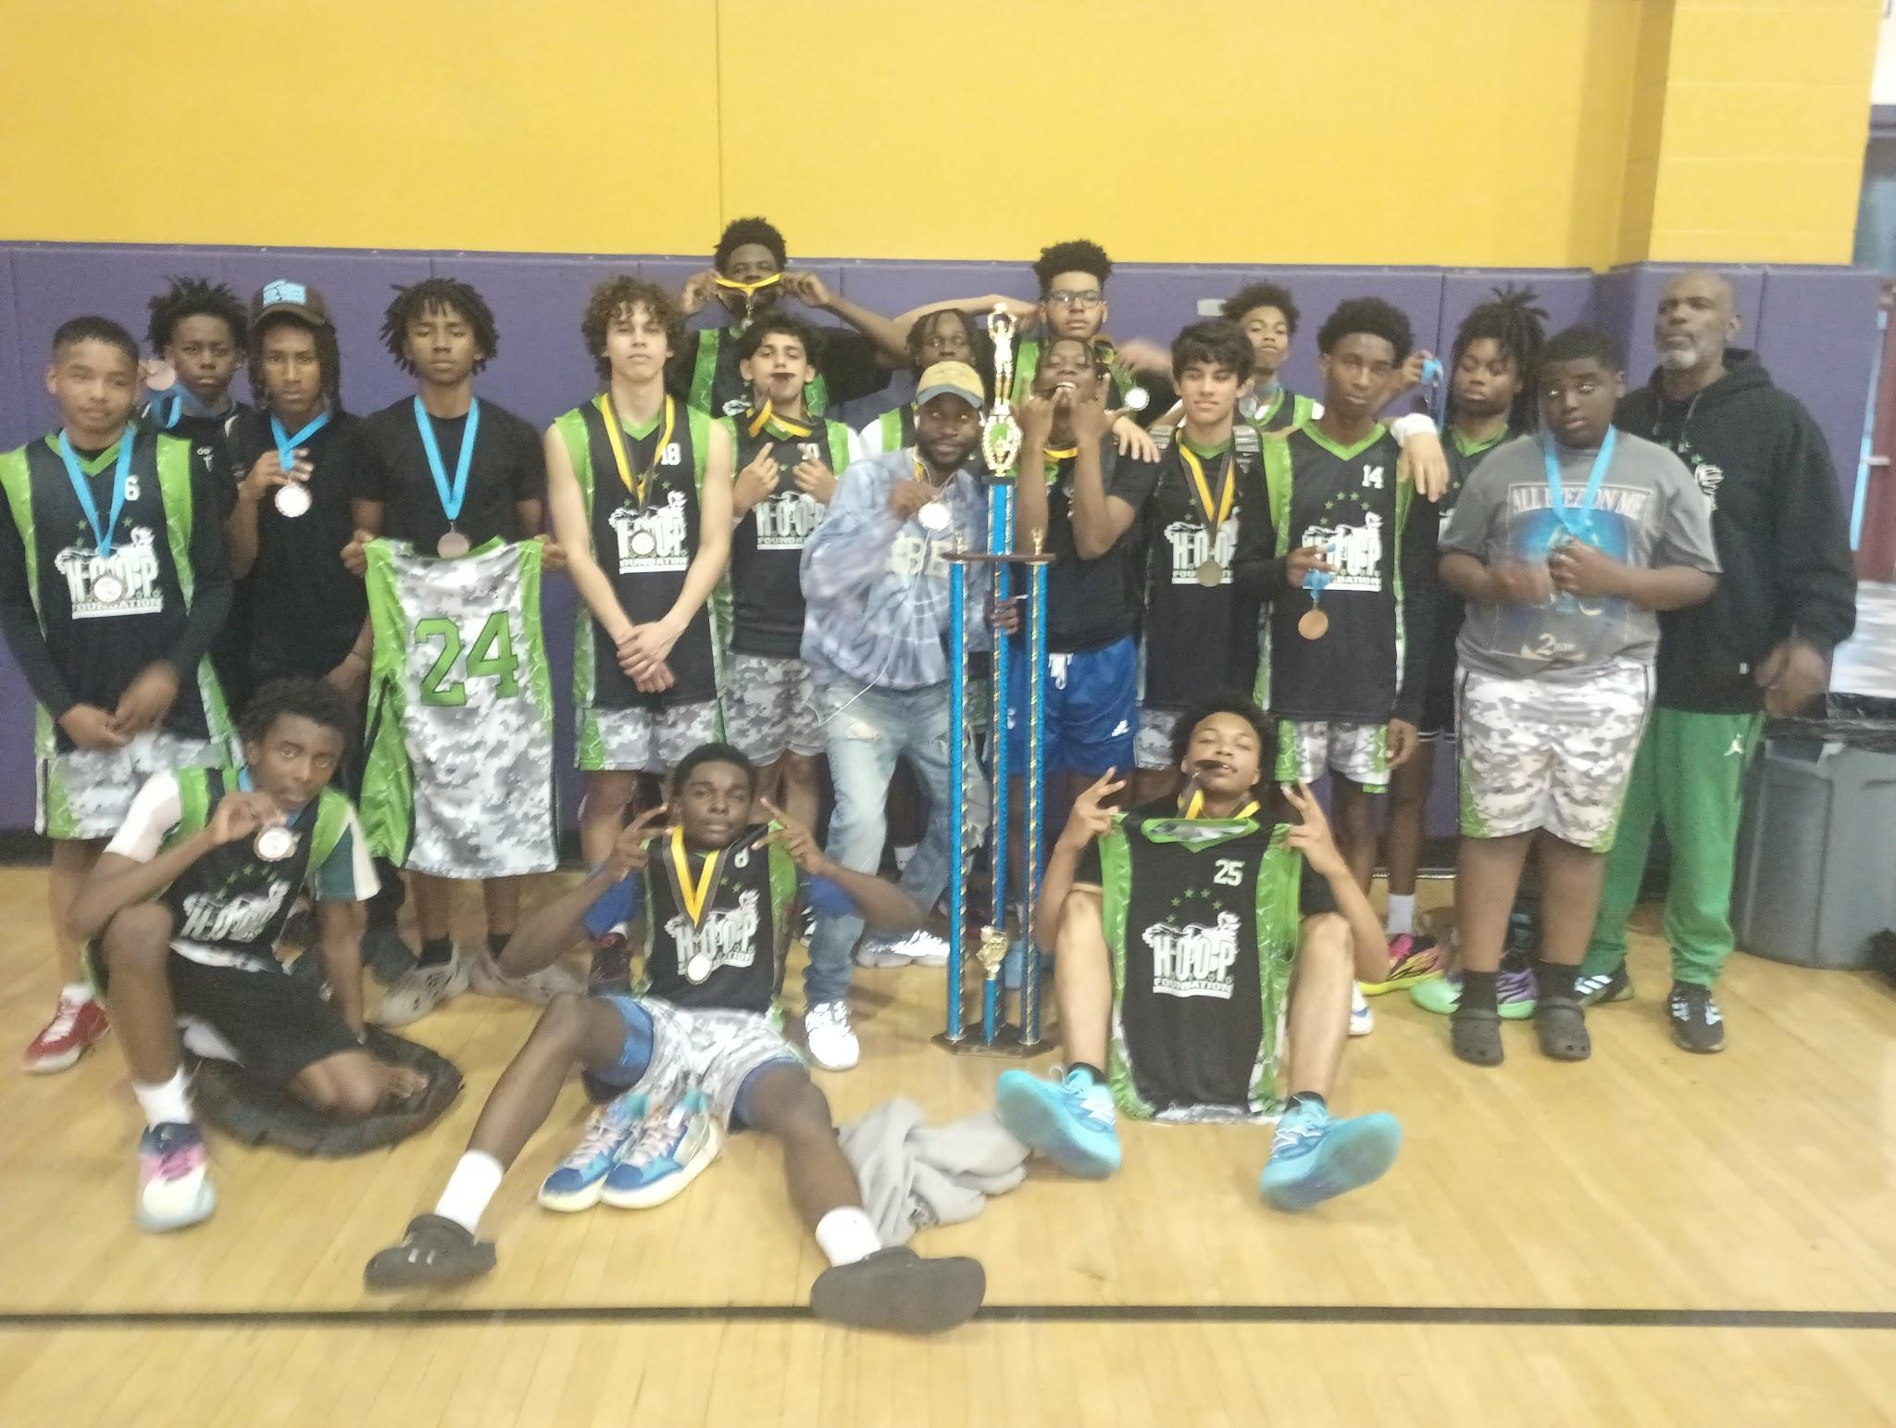
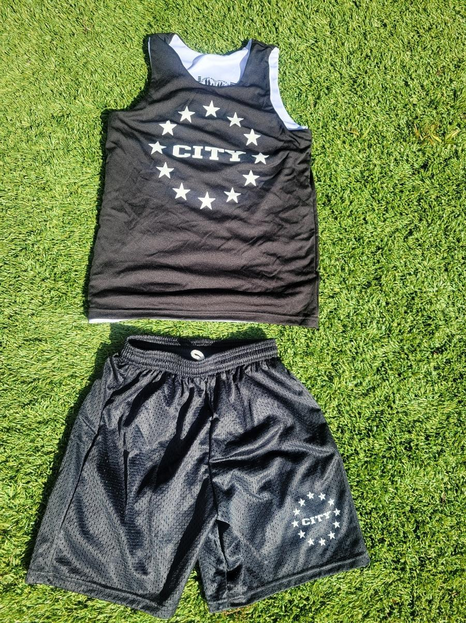
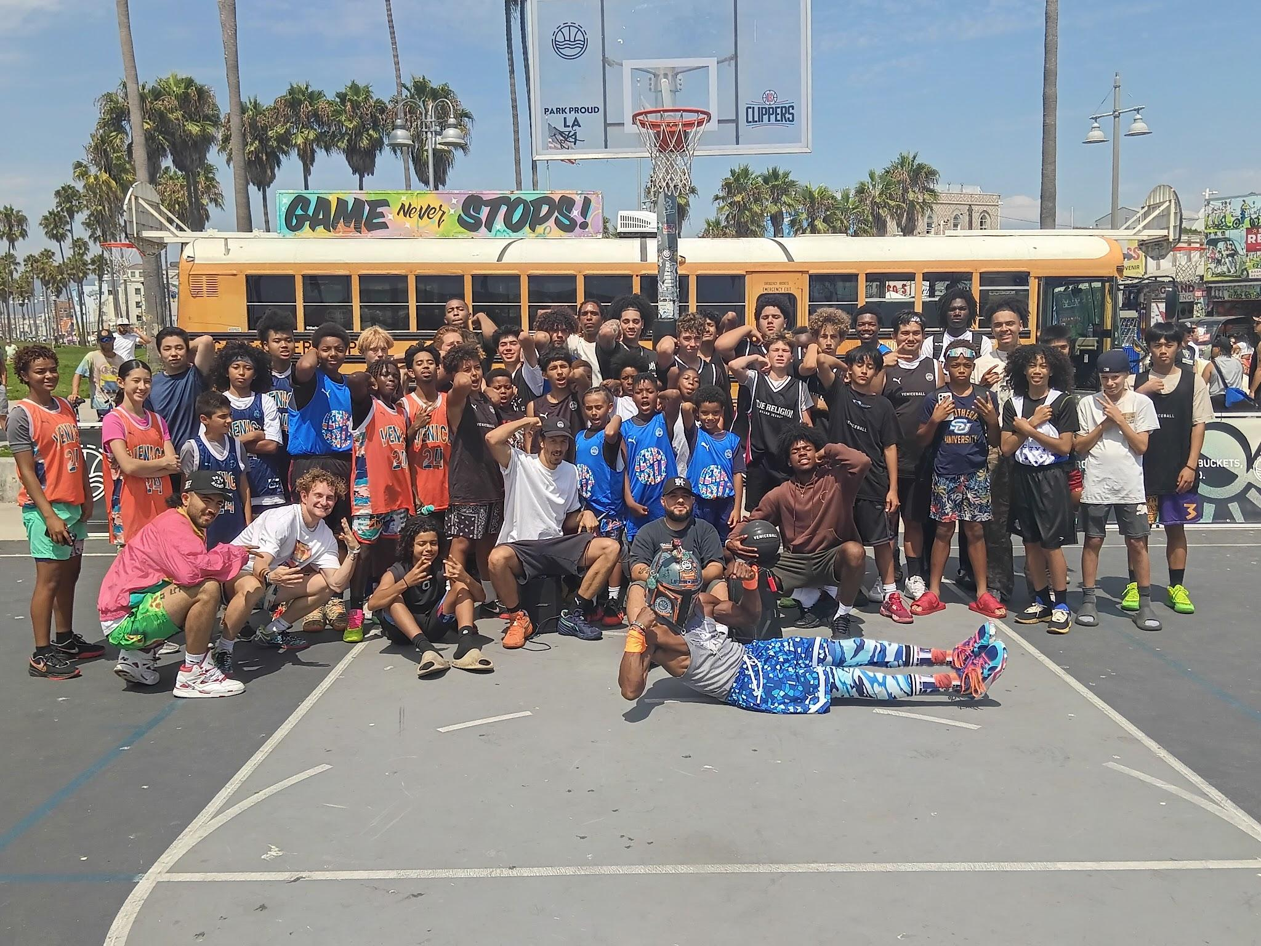
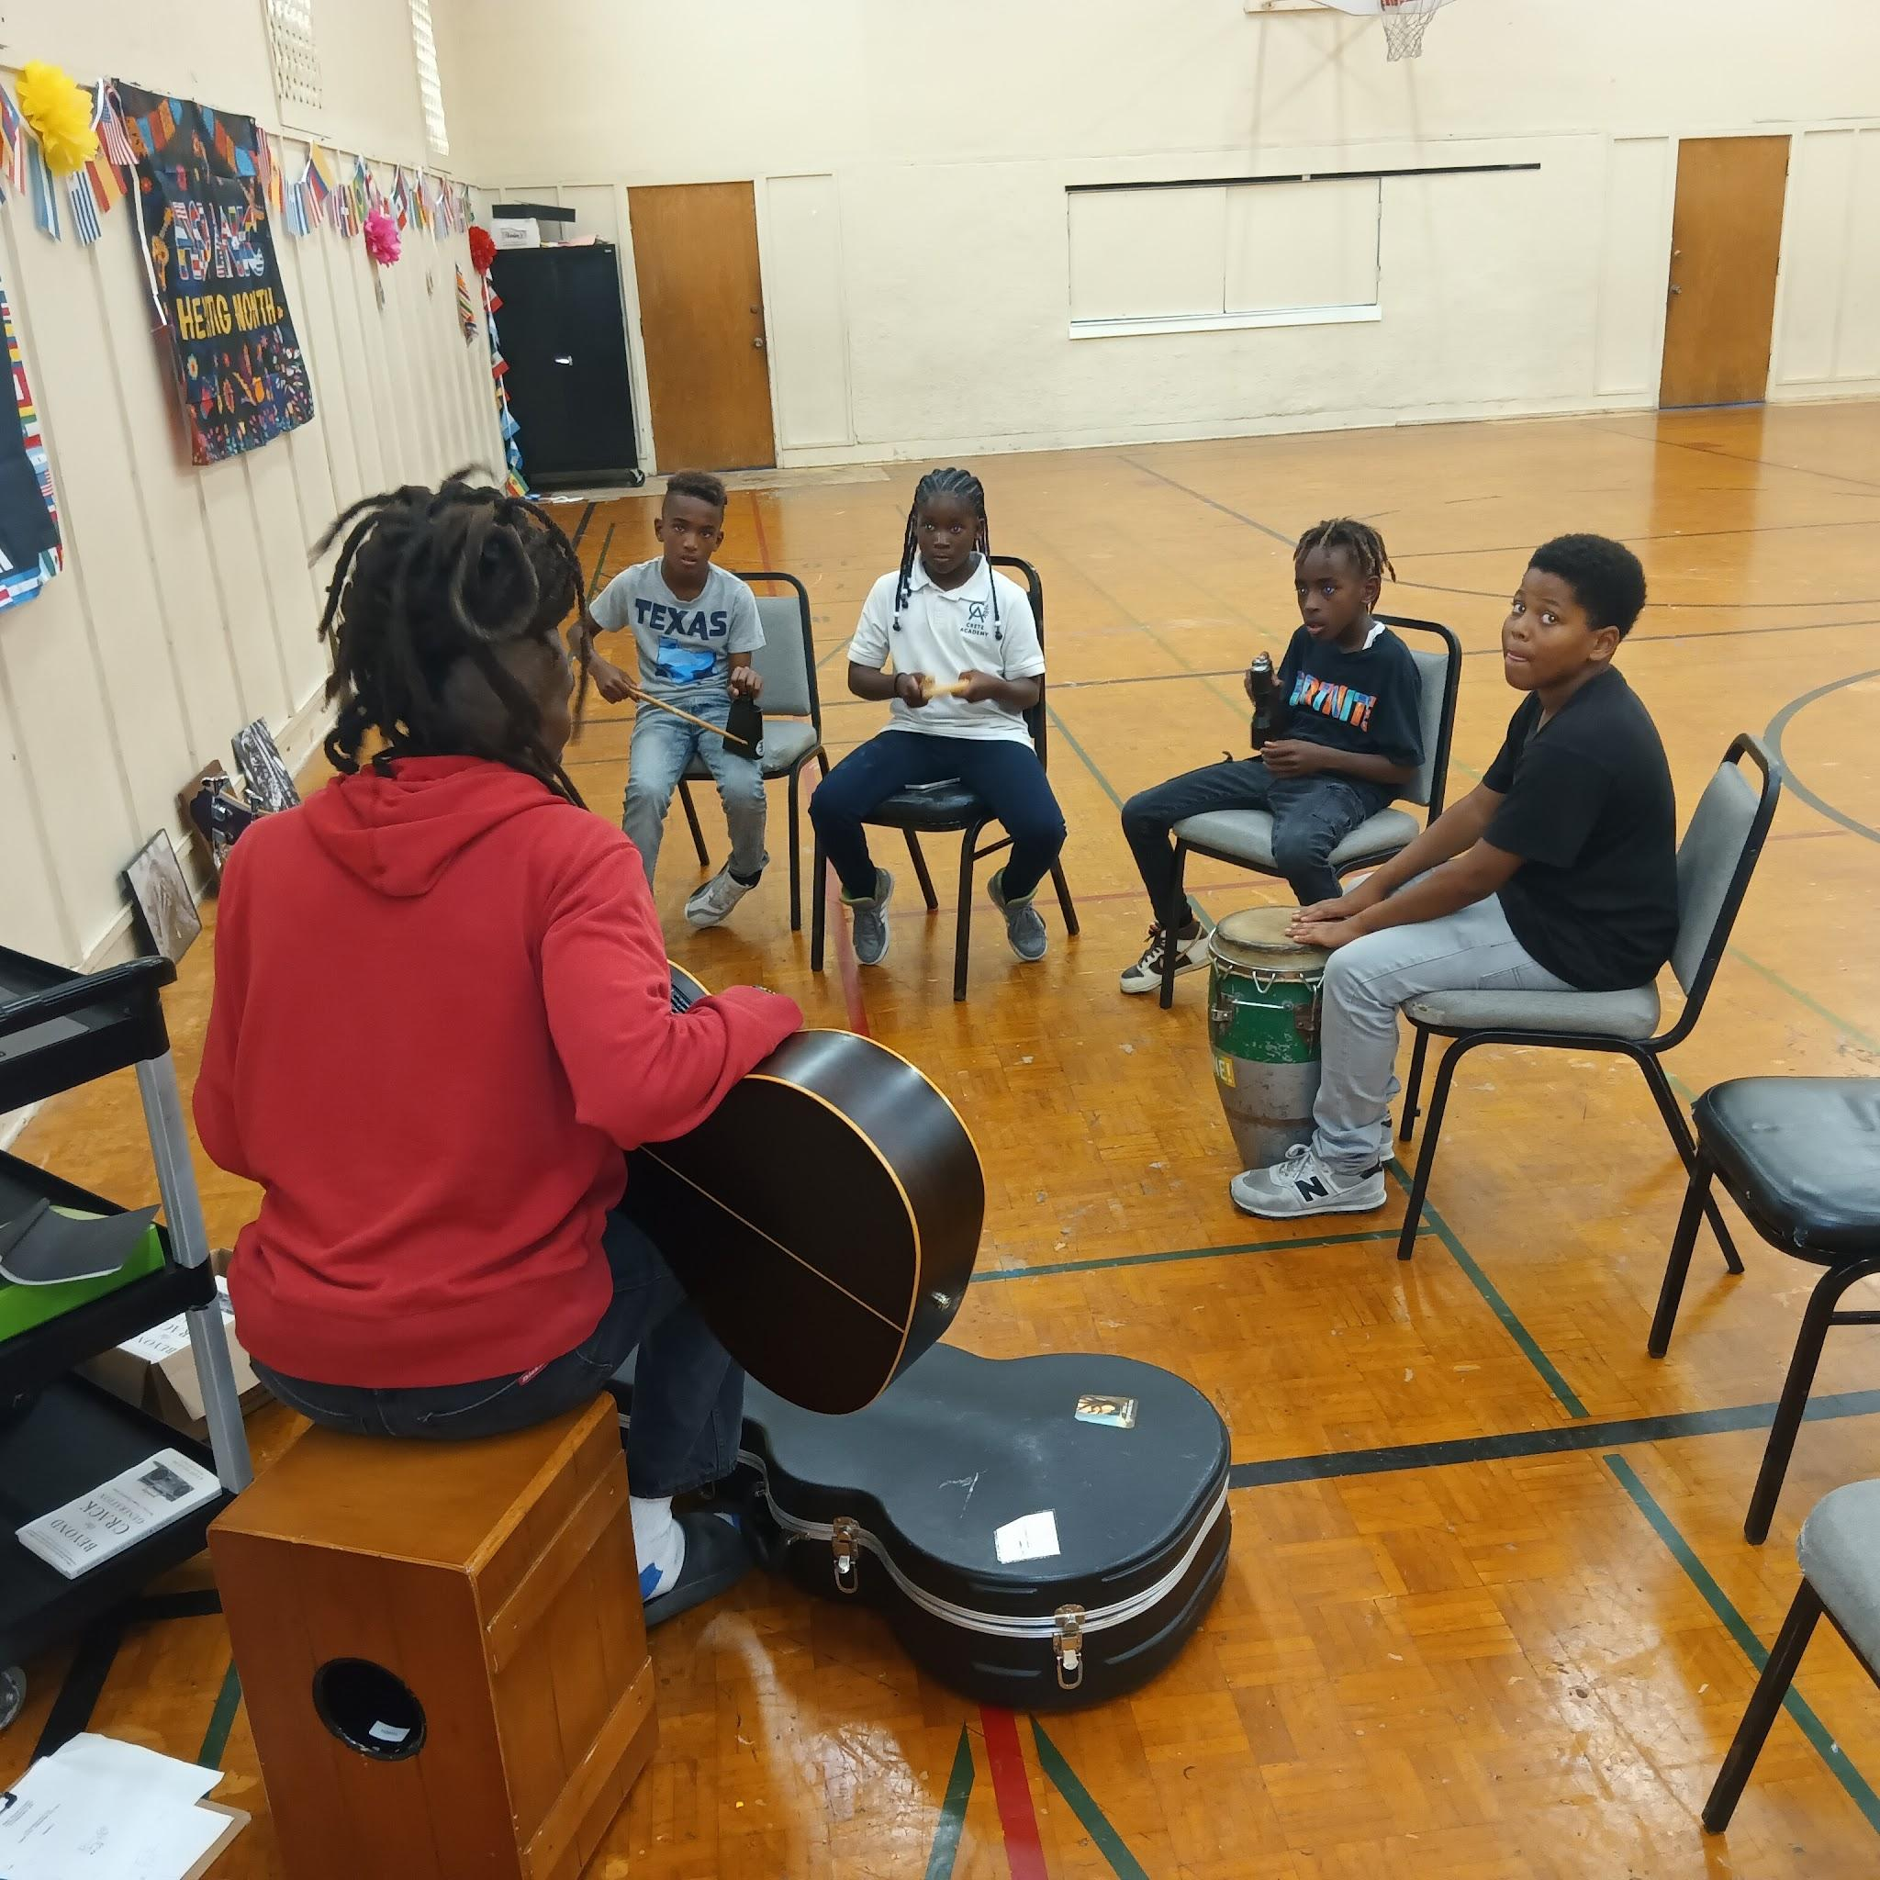
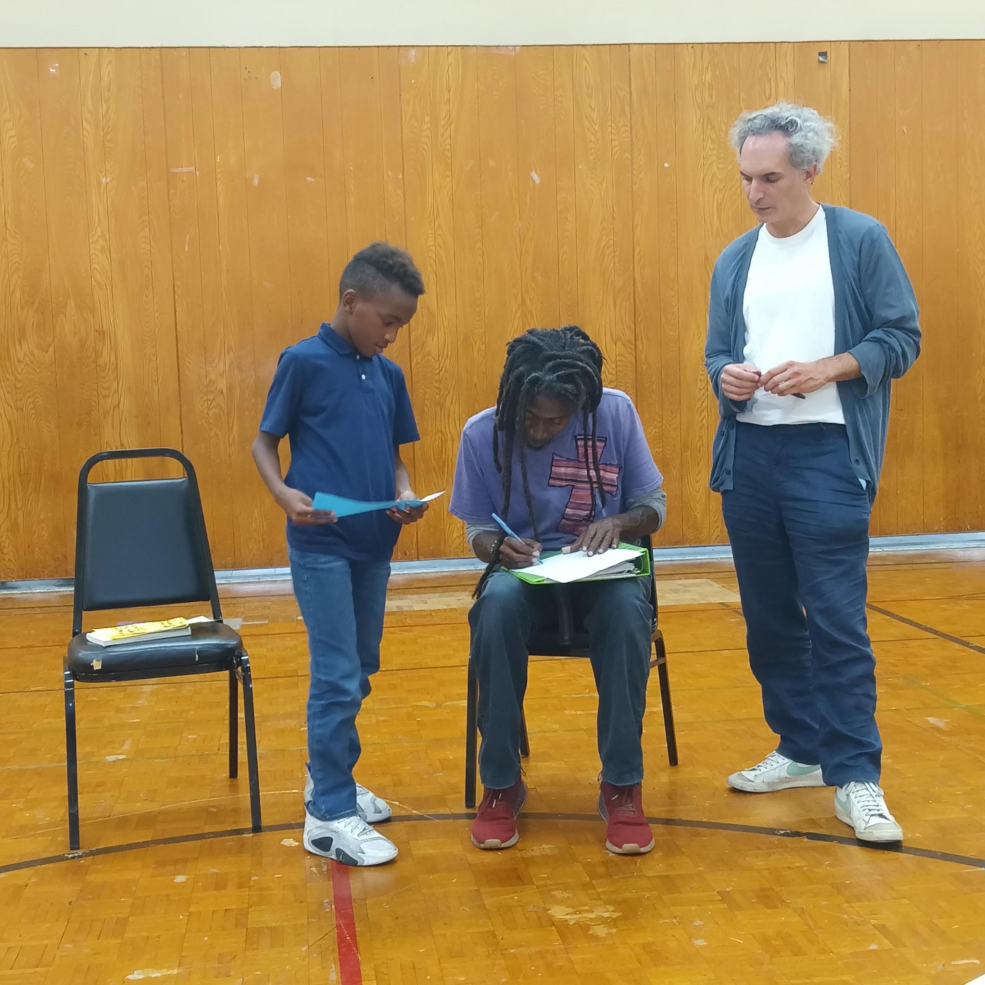
2023
Venice Basketball League
HOOP Bus
9U AAU Team
(Seal Beach, CA)
17U AAU Team
(Lynwood, CA)
2024
City Stars / HOOP Foundation Merger
HOOP Bus
(Venice Beach, CA)
Dollar General Literacy Foundation - Family Literacy Program
(Inglewood, CA)
A 501 (c) (3) Charitable Organization Federal Tax ID #80-0228843

Slide 9
Success By The Numbers… Since 2008
Over 2500 Toys distributed
Over 1000 Father Engagements
Over $240,000.00 raised
Fundraising, Grants, & Donations
Over 250 High School Graduates
Over 50 Partner Organizations
Over 5000 Youth and Families Served
A 501 (c) (3) Charitable Organization Federal Tax ID #80-0228843

Slide 10
2025 Important Dates – Board of Directors Meetings
January 13th Regular Meeting
February 10th: Regular Meeting
March 10th: Regular Meeting
April 14th : Regular Meeting
May 12th: Regular Meeting
June 9th: Regular Meeting
July 14^{th:} Regular Meeting
August 11th Regular Meeting
September 8th Regular Meeting
October 13th Regular Meeting
November 10th Regular Meeting
December No Meeting

Slide 11
2025 Important Dates
February 14th Valentine Fundraiser
April 11th 18th Year Anniversary
May 6th Board Fundraiser
June 11th KVBL Summer Camp
July 16^{th:} 18th Year Celebration
December 13th Shoes II Fill Toy Drive

Slide 12
2025 Strategic Plan
P.A.S.S. I.T.
Physically - Basketball Skills Training, Weekend Tournaments, Summer Camp
Academically - Tutoring & Homework Assistance
Socially - Weekend Basketball Tournaments, Basketball Leagues
Spiritually - Life-Skills, Summer Camp
Integrity - Life-Skills, Summer Camp
Truth – All Programs

Slide 13
2024 Highlights
2024 Highlights
Program Achievements
City Stars / H. O, O. P. - AAU Basketball Team, Mentor, and Youth Development Program
Successfully registered 75 students in grades 2 through 8.
Provided over 1,200 hours of basketball training, mentorship, and youth development activities.
Family Literacy Program
Partnered with the Dollar General Foundation to host 10 literacy workshops.
Distributed over 500 books and established a small community library through support from The Lisa Libraries.
Career Training Expansion
Developed a proposal to secure funding from the various foundations to develop career training tracks within the After School Program.
Developed a proposal for Pilot internship opportunities for 15 high school students in STEM, healthcare, and digital media fields.

Slide 14
Brief Financial Overview
Brief Financial Overview
Revenue
Grants: $5,000
Board Donations: $4,410.00
Private Donations: $2,500.00
Program Registration: $1,066.00
Expenses
Auto Expense: $1,595.08 (Fuel, Parking & Maintenance)
Auto Insurance: $4,187.93
Fundraising Expense - $1,902.46
Program Operations: $2,700.00
Net Income: $575.32

Slide 15
2024 Recognition / 2025 Goals
Recognition and Awards
Los Angeles Trial Lawyers’ Charities (LATLC): Acknowledged for five consecutive years of impactful grant utilization.
Elizabeth A. Lynn Foundation: Recognized for excellence in literacy program delivery.
Goals for 2025
Enhance Career Training Programs
Establish formal partnerships with local businesses to provide 50 internship opportunities.
Strengthen Community Engagement
Host quarterly events to deepen relationships with stakeholders and beneficiaries.
Increase Funding
Identify and apply for at least five new grant opportunities.

Slide 16
Closing Remarks
Closing Remarks
As we close another successful year, I want to extend my deepest thanks to each of you. Your leadership and commitment make the H.O.O.P. Foundation’s work possible. With your continued support, we look forward to achieving even greater heights in 2025.
Warm regards, Bryan C. Jones Executive Director H.O.O.P. Foundation

